Slide 1
Statistical detection of deepfake videos and images
Guided By:- Dr. Gayatri Behere Mam
Presented By:-
Miss Disha .R. Sojrani
M.Sc. Sem III,
Department of Statistics
Institute of Science, Nagpur

Slide 2
content
Introduction.
Primary Goal.
Objectives.
Summary of Research Paper.
Why I choose this project??
Methodology.
Dataset.
Machine Learning and Deep Learning Models.
Expected Outcomes
Conclusion
References

Slide 3
introduction
Deepfakes—AI-generated or AI-manipulated images and videos—have become a serious threat to online trust and digital security. With advanced generative models, malicious actors can produce highly realistic media that is often indistinguishable from authentic content.
This project focuses on the statistical detection of deepfake videos and images using machine learning, combining classical signal-processing techniques with modern learning-based approaches to achieve reliable and scalable detection.
The study explores how statistical artifacts differ between real and manipulated media, by analyzing:
Noise residuals
Frequency-domain patterns (DCT/FFT)
Color channel inconsistencies
Compression signatures
Temporal cues (eye-blink rate, lip-sync mismatch)
Physiological/geometry cues (head-pose, lighting, specular highlights)
These features are integrated into machine learning pipelines—ranging from traditional classifiers to deep neural networks—to establish robust decision boundaries for detecting forgery.

Slide 4
Primary goals
The project aims to:
Identify patterns that reliably distinguish authentic from manipulated media.
Evaluate robustness of detection models under common post-processing (compression, scaling, filtering) and across different deepfake generation methods.
Predict forgery likelihood on unseen samples, ensuring practical applicability.
Assess generalization of models trained on one type of deepfake when applied to others, especially in low-quality, user-generated content.
Compare feature families and model types (statistical, spatial, temporal; ML vs. DL) for both images and videos.
Report evaluation metrics such as Accuracy, Precision, Recall, F1-score, and ROC-AUC.
Consider practical aspects like inference speed, scalability, and deployment feasibility.

Slide 5
OBJECTIVES
The main objective of this work is to analyze the statistical characteristics of real and manipulated media by extracting features such as noise residuals, frequency components, and color inconsistencies. Machine learning models will be designed and implemented to classify images and videos as authentic or deepfake, with a comparison of algorithms like SVM, Random Forest, CNN, and RNN. The study further aims to evaluate model robustness under different conditions such as compression, scaling, noise, and low resolution, while also investigating the effectiveness of temporal features such as lip-sync mismatch, eye-blink rate, and head movement in video-based detection. Finally, the research seeks to identify the most effective feature sets (statistical, spatial, or temporal) and develop a real-time predictive framework for flagging suspicious media across different datasets and deep fake generation techniques.

Slide 6
Summary of Research Paper
Research Paper 1
Title: A Comprehensive Review of Deepfake and its Detection Techniques
Authors: Tatwadarshi P. Nagarhalli, Ashwini Save, Sanket Patil & Uday Aswalekar (India)
Published: August 2024
Summary:
This paper reviews the evolution of deepfake technology and its impact on digital trust. It provides a comparative analysis of 14 research works, focusing on detection methods based on statistical features, machine learning, and multimodal approaches. The authors discuss challenges such as dataset bias, poor generalization across generation methods, and the continuous advancements in deepfake creation tools. The paper concludes by recommending the development of robust, scalable, and explainable detection techniques to ensure reliable identification of manipulated media in real-world applications.

Slide 7
Summary of Research Paper
Research Paper 2
Title: A Hybrid CNN-LSTM Model for Video Deepfake Detection by Leveraging Optical Flow Features
Authors: Pallabi Saikia, Dhwani Dholaria, Priyanka Yadav, Vaidehi Patel & Mohendra Roy (India)
Published: July 2022
Summary:
This study introduces a hybrid CNN-LSTM architecture for deepfake detection in videos, using optical flow to capture motion-based inconsistencies between frames. The proposed model was tested on benchmark datasets such as DFDC, FaceForensics++, and Celeb-DF, achieving high accuracy levels (91.21% on FF++, 79.49% on Celeb-DF). The research highlights the importance of combining spatial and temporal features for reliable detection, especially in compressed or low-quality videos. The paper suggests that hybrid models can significantly improve the robustness of deepfake detection in practical scenarios.

Slide 8
Summary of Research Paper
Research Paper 3
Title: Deepfake Detection Using Convolutional Neural Networks and LSTM Modelling
Authors: Vishal Manishbhai Patel & Dr. Sheshang Degadwala (India)
Published: 2025 (International Journal of Scientific Research in Science and Technology)
Summary:
This study proposes an advanced detection framework that integrates CNN for extracting spatial features and LSTM for temporal consistency analysis from video frames. Tested on benchmark datasets, the model achieved exceptional results with 97% accuracy, precision, recall, and F1-score, demonstrating its effectiveness in capturing both frame-level details and inter-frame dynamics for robust deepfake identification.

Slide 9
Why I choose this project??
I choose this research on deepfake detection because of its rising importance in today’s digital world. With the growth of social media and advanced AI tools, deepfakes have become easier to create and harder to detect, posing serious threats to trust, privacy, and security. Their misuse is not limited to entertainment but also extends to politics, financial fraud, cybercrime, and misinformation campaigns, which can mislead people and harm reputations.
This project is especially relevant as many existing detection models struggle with generalization across different deepfake techniques and with low-quality or compressed media commonly shared online. By focusing on statistical features combined with machine learning, our study aims to build an effective and scalable detection framework, addressing a global challenge and contributing to safer, more transparent online platforms.

Slide 10
Cheat Sheet
Statistical Features: Quantitative measures (like noise patterns, frequency components, color inconsistencies) that help differentiate real from fake media.
Spatial Features: Visual details in a single frame/image such as texture, edges, lighting, and pixel distribution.
Temporal Features: Motion-based cues in videos, such as lip-sync mismatch, abnormal eye blinking, or unnatural head movements.
Deepfake: AI-generated or AI-manipulated image/video that makes people appear to say or do things that never happened.
P2P (Pixel-to-Pixel Analysis): Comparing pixel-level details of an image/video to detect subtle anomalies introduced during manipulation.
F2F (Frame-to-Frame Analysis): Studying the continuity between consecutive video frames to catch inconsistencies in movement or transitions.
CNN (Convolutional Neural Network): A deep learning model that analyzes images by detecting spatial patterns and anomalies.
Forgery Cues: Inconsistencies like unnatural lighting, mismatched shadows, blurred boundaries, or audio-visual mismatch.
Evaluation Metrics: Measures such as Accuracy, Precision, Recall, F1-score, and ROC-AUC used to assess detection model performance.

Slide 11
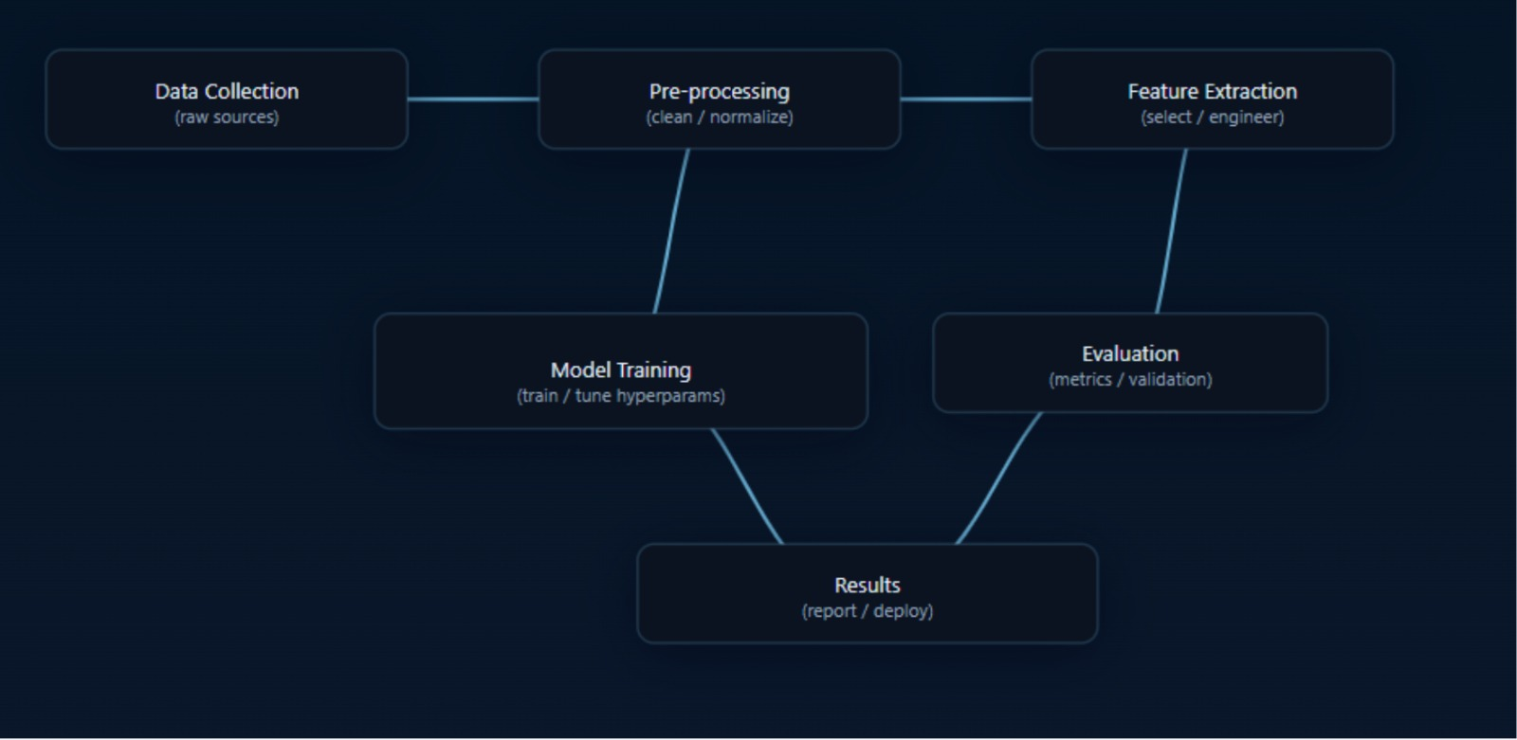

Slide 12
methodology
Step-1: Data Collection:-
Gather real and deepfake datasets (e.g., FaceForensics++, Celeb-DF, Deepfake Detection Challenge dataset).
Ensure diversity: multiple formats, resolutions, and subjects.
Step-2: Data Pre-processing:-
Frame extraction from videos.
Image resizing, noise reduction, and normalization.
Face detection and alignment (using OpenCV, Dlib, etc.).
Step-3: Feature Extraction (Statistical + Visual):-
Pixel-level statistics: mean, variance, skewness, kurtosis.
Frequency-domain analysis: DCT, FFT, wavelet transforms.
Noise patterns & inconsistencies: color distribution, compression artifacts.
Texture features: Local Binary Patterns (LBP), GLCM.

Slide 13
Step-4: Machine Learning / Deep Learning Model:-
Classical ML models: Logistic Regression, SVM, Random Forest.
Deep Learning models: CNN-based classifiers.
Model trained on extracted features.
Step-5: Model Training & Validation:-
Split data into training, testing, and validation sets.
Use k-fold cross-validation for robustness.
Optimize hyperparameters for best accuracy.
Step-6: Performance Evaluation:-
Metrics: Accuracy, Precision, Recall, F1-score, AUC.
Confusion matrix to analyze classification errors.
Step-7: Result & Interpretation:-
Comparison of statistical methods vs deep learning methods.
Identify strengths/limitations of each approach.
Step-8: Conclusion & Future Work:-
Highlight effectiveness of combining statistics + ML.
Suggest improvements (real-time detection, lightweight models, adversarial training).

Slide 14
dataset
Collected dataset includes real and deepfake images/videos.
Real media: original, unaltered images/videos of multiple subjects.
Deepfake media: generated using GANs, face-swapping, lip-sync, expression manipulation.
Balanced dataset for training (equal number of real & fake samples).
Used publicly available datasets:
  FaceForensics++
  Celeb-DF (v2)
  Deepfake Detection Challenge (DFDC)

Slide 15
Key Statistical Features
Noise-Based: PRNU (sensor noise), compression artifacts (JPEG blocks, blur), RGB color inconsistencies.
Frequency-Domain: FFT (frequency artifacts), DCT (compression traces), Wavelet (multi-resolution textures).
Texture & Structural: GLCM (contrast, correlation), LBP (local texture), edge/boundary sharpness.
Temporal (Videos): Frame inconsistencies, eye blinking rate, lip-sync mismatch, abnormal head movement.
Pixel-Level: Mean, Variance (brightness/contrast), Skewness & Kurtosis (pixel intensity distribution).

Slide 16
Machine Learning & Deep Learning Models
Machine Learning (ML):
  Logistic Regression → simple binary classification.
  SVM → separates real vs fake with optimal boundary.
  Random Forest → ensemble, handles noisy features.
Deep Learning (DL):
  CNN → extracts features automatically from images.
  RNN / LSTM → analyzes temporal info in videos.
  CNN + LSTM → combines spatial & temporal features.

Slide 17
Expected Outcomes
A machine learning framework that can classify images/videos as real or fake with high accuracy.
Identification of which statistical, spatial, frequency, or temporal features are most useful in distinguishing real from fake content.
Comparative performance results of different algorithms (SVM, Random Forest, CNN, LSTM, etc.) to find the best-suited model.
Evaluation of models under real-world conditions such as compression, scaling, noise, and low resolution.
Insights into how well the detection model trained on one dataset works across other datasets and deepfake generation methods.
A prototype tool or pipeline capable of predicting/managing deepfake content in near real-time.
Contribution to the field of digital media forensics by providing a scalable and explainable detection approach.

Slide 18
conclusion
Deepfake detection is essential to preserve trust in digital media. Our approach, using statistical features with machine learning, effectively uncovers hidden artifacts in manipulated content. While challenges remain with low-quality and evolving techniques, continued research and collaboration are vital to strengthen digital security and combat misinformation.

Slide 19
references
Saikia, P., Dholaria, D., Yadav, P., Patel, V., & Roy, M. (2022). A Hybrid CNN-LSTM Model for Video Deepfake Detection by Leveraging Optical Flow Features. arXiv preprint arXiv:2208.00788. Retrieved from https://arxiv.org/abs/2208.00788
Nagarhalli, T. P., Save, A., Patil, S., & Aswalekar, U. (2024). A Comprehensive Review of Deepfake and its Detection Techniques. ResearchGate. Retrieved from https://www.researchgate.net/publication/384122887_A_Comprehensive_Review_of_Deepfake_and_its_Detection_Techniques
Rossler, A., Cozzolino, D., Verdoliva, L., Riess, C., Thies, J., & Nießner, M. (2019). FaceForensics++: Learning to detect manipulated facial images. In Proceedings of the IEEE/CVF International Conference on Computer Vision (ICCV), 1–11.
The Hindu / Indian Express articles on deepfakes in politics.

Slide 20
Thank
You
Presented by:-
Disha .R. Sojrani

